Slide 1
RECAP: Rapid Event-level Classification of Affected Properties
By: Yatin Raju, Aryan Anand, and Sri Satishkumar
Notes:
Hi everyone, the project we are building is called RECAP, which turns before and after satellite images into building-level damage labels with calibrated confidence, then shows the results on a simple map. In short, our system helps responders see where damage is most likely, fast.”

Slide 2
Why This Project Matters
The problem
After disasters, responders need to know: which buildings are safe, damaged, or destroyed?
Field surveys are slow and dangerous. Satellite imagery arrives quickly, but raw photos are not actionable.
The opportunity
AI can turn pre/post satellite images into building-level damage maps.
This gives responders fast, clear, and safe situational awareness.
The impact
Faster response: focus inspections where they matter most.
Smarter resource use: guide shelters, supplies, and aid.
Accessible tool: simple map anyone can use, not just experts.
Notes:
Problem
“After disasters, responders need to know which buildings are safe, damaged, or destroyed. Field surveys are slow and risky. Satellite imagery arrives quickly, but raw photos are not actionable.”
Opportunity
“AI can compare pre and post images and produce a building-level damage map that people can use right away.”
Impact
“Faster response by focusing inspections where they matter most.
Smarter resource use for shelters, supplies, and aid.
An accessible tool in a simple map, not just for experts.”
Transition to Presenter 2:
“Now that you have the why, here is the core idea of what we are building.”

Slide 3
Idea and Constraints
Idea
Use publicly available “before and after” satellite images to train a model that classifies each building’s damage level:
No Damage
Minor Damage
Major Damage
Destroyed
Display the results on a simple, interactive map for quick situational awareness.
Constraints
No live satellite tasking, use existing public imagery.

Slide 4
Data and Method
Data
xView2/xBD: Pre- and post-disaster imagery, building footprints, 4 damage classes.
Method
Model: Siamese ResNet-18 on paired building crops (224–256 px).
Outputs: Damage label + calibrated confidence score.
Evaluation
Splits: Train/test by disaster event (no leakage).
Metrics: Precision, Recall, F1 per class; Macro-F1 overall.
Notes:
“We use xView2/xBD with paired pre and post imagery, building footprints, and four damage classes.”
“Our baseline is a Siamese ResNet-18 on paired building crops at about 224 to 256 pixels. The model outputs a damage label plus a calibrated confidence score so thresholds behave predictably in the app.”
“We split by disaster event to avoid leakage between train and test. We report Precision, Recall, and F1 per class, and Macro-F1 overall as the main metric.”

Slide 5
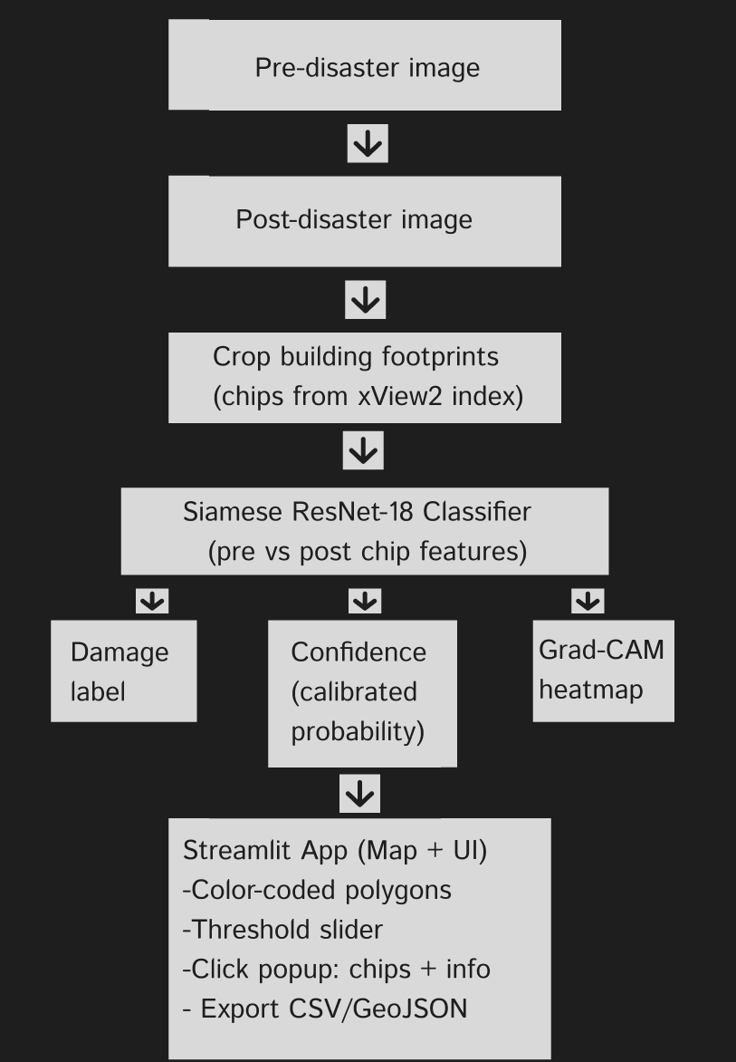
High-level architecture
Notes:
“This diagram shows how our system works from start to finish.
We begin with a pre-disaster satellite image and a post-disaster image of the same area. From those, we crop around each building footprint provided in the xView2 dataset. Each building now has a before-and-after pair.
These paired crops go into our Siamese ResNet-18 model, which compares the two images and predicts the level of damage. The model produces three outputs: a damage label like no, minor, major, or destroyed; a confidence score that tells us how sure the model is; and an optional Grad-CAM heatmap that highlights which parts of the image influenced the decision.
Finally, all of this is displayed in our Streamlit app. On the map, buildings are color-coded by damage level, and users can filter with a confidence slider. Clicking a building brings up its before/after images and prediction details, and the results can also be exported as CSV or GeoJSON for further use.”

Slide 6
Thank you for listening

